Slide 1
Evaluating LLM Agents in Black-Box Auctions

Slide 2

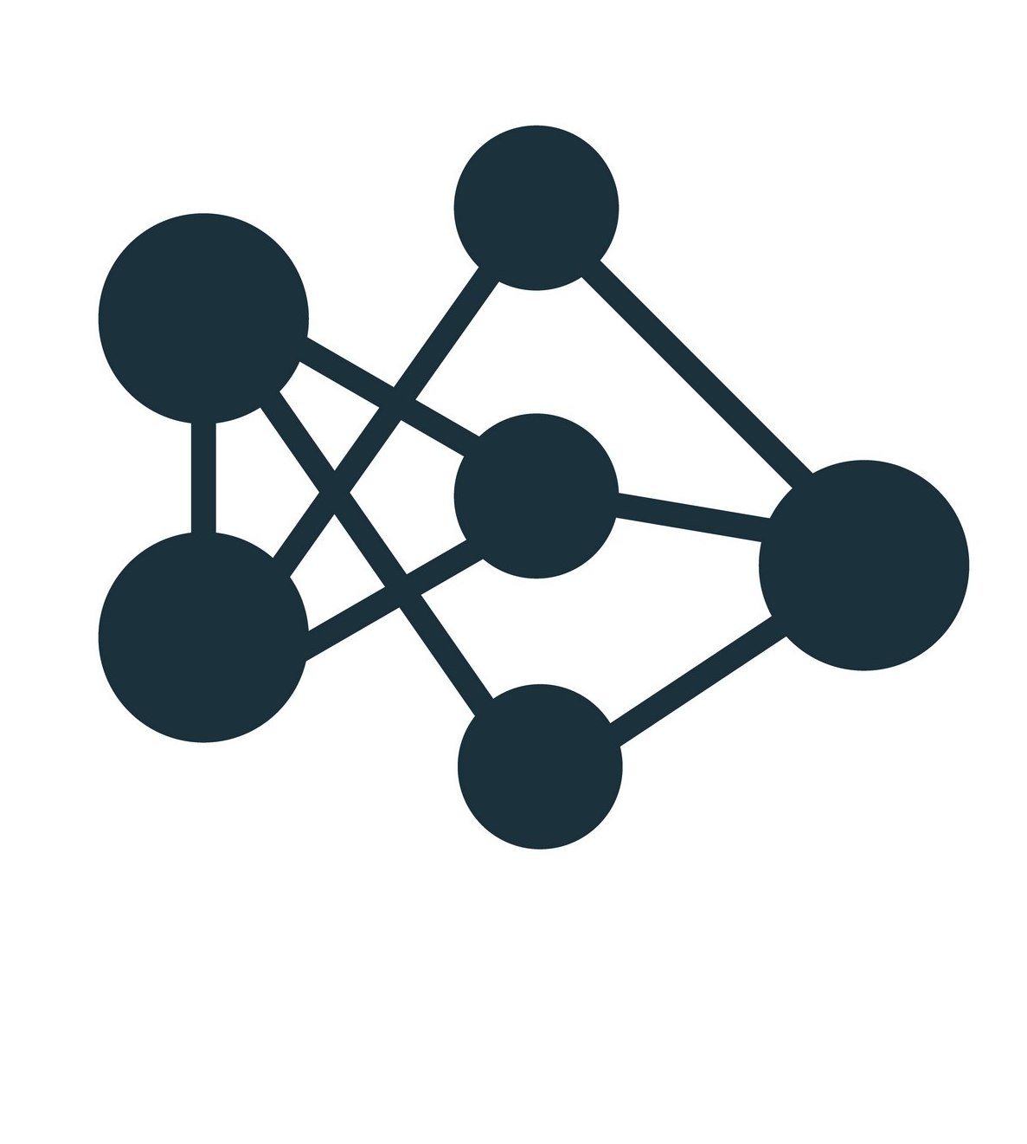
Background and Motivation
Neural Network Mechanisms can model complex auctions with multiple items
LLM bidders relatively new, the next step in optimizing auctions
Example Uses in real world: Alibaba evaluating advertisements in online auctions after a search query is sent by a user
Menu Option
Allocation, Payment
LLM Bids
MenuNet

Slide 3
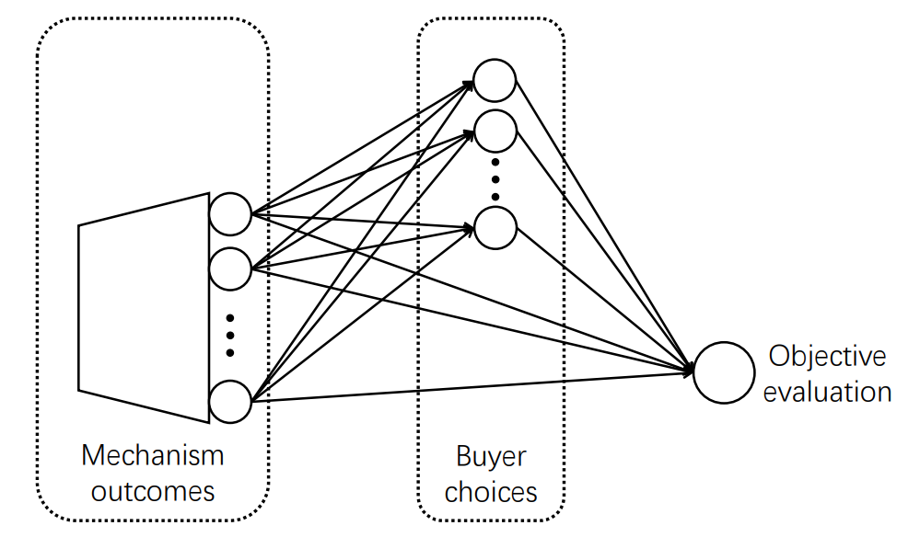
Our Research
Evaluating LLMs effectiveness in Neural Network Auctions
Implement MenuNet as our neural network auction
Use ChatGPT as our LLM bidder

